Slide 1
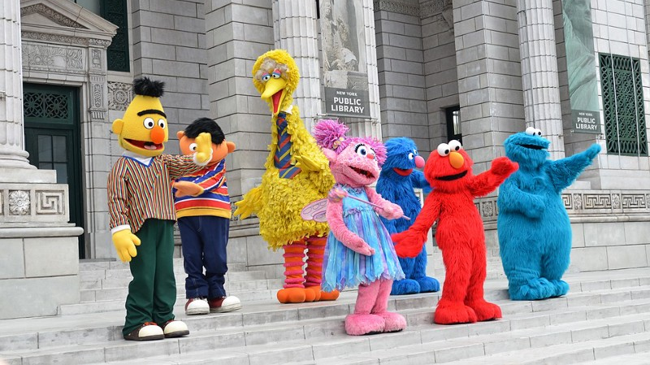
ELMo, BERT, OpenAI-GPT & Family
Marc Altmeyer, Tatiana Anikina, Sourav Dutta, Vanessa Hahn

Slide 2
Overview:
Motivation
Contextual Embeddings
OpenAI GPT
Conclusion
BERT
CoVe and ELMo

Slide 3
Motivation
Word2Vec, GloVe & fastText are good but …
They are learned based on word concurrencies and do not capture sequential context!
“I am eating an apple” vs “I have an Apple phone”​
“John likes playing football” vs “John likes playing his role”​

Slide 4


Slide 5
Motivation
We need context-aware embeddings.
We also want our models to be flexible and adaptive to new domains.
Ideally, we want to have a model which can be easily plugged into existing neural architecture trained for a specific task, without wasting training time!
Our goal: context-sensitive embeddings & transfer learning!​

Slide 6
Contextual Embeddings
Contextual Word Vectors or CoVe (McCann et al. 2017) were inspired by neural Machine Translation.
CoVe embeddings are learned by an encoder in a translation model.
CoVe use seq-to-seq attentional translation model.
Before we move on to CoVe, we should introduce:​
LSTM, Seq-to-Seq and Attention​

Slide 7
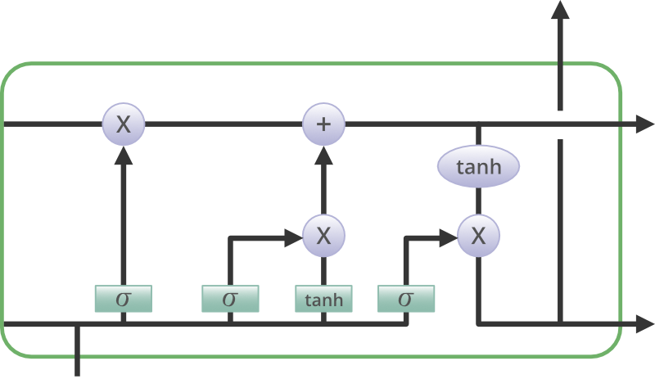
Long Short Term Memory: big picture

Slide 8
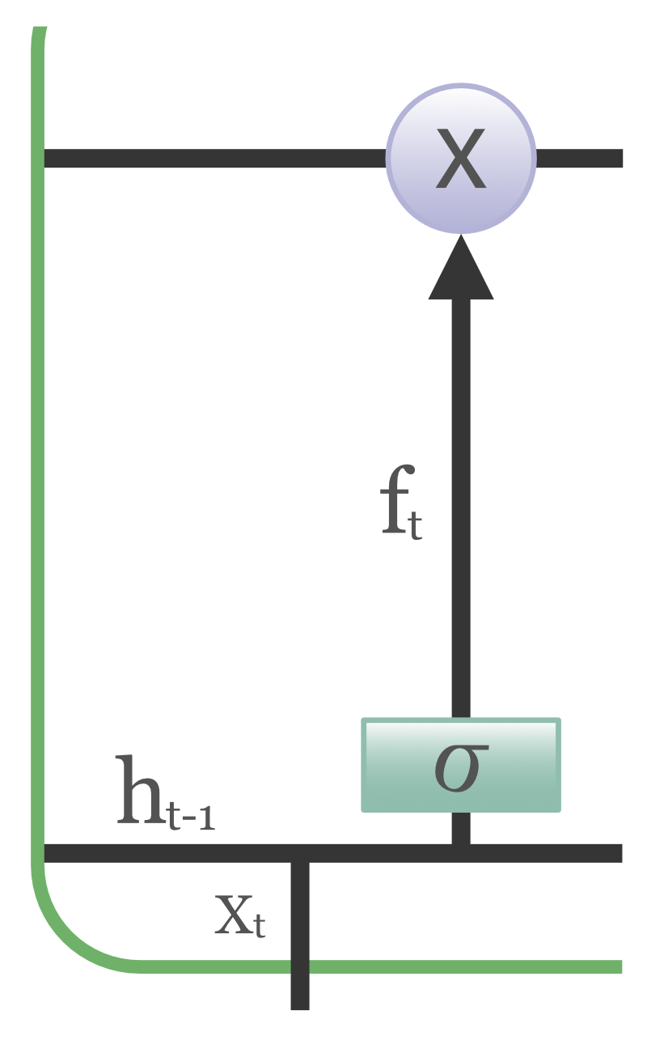

LSTM: forget gate
Forget gate removes the information that is no longer useful.
Current input xt and previous cell output ht-1 are multiplied with the weight matrices plus the bias.
The result is passed through an activation function which gives a binary output.
If the output is 0, the information is forgotten and for the output 1, it is retained.

Slide 9
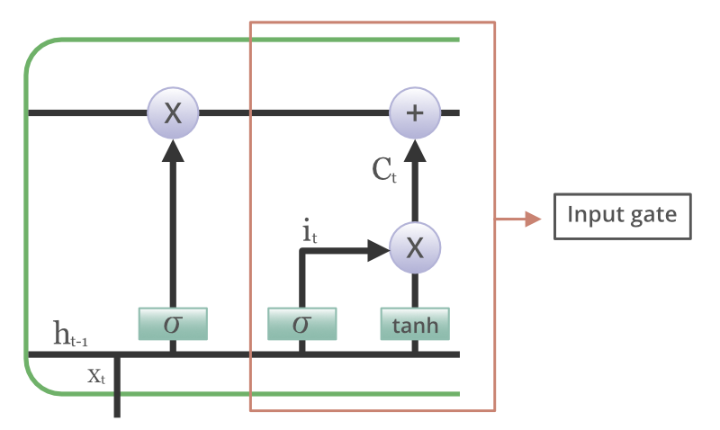

LSTM: input gate
Input gate adds new information to the cell state.
First, it applies a sigmoid function to the inputs ht-1 and xt.
Second, it creates a vector with the tanh function, which contains all values from ht-1 and xt.
Third, the values of the vector and the selected values are multiplied to obtain the useful information.

Slide 10
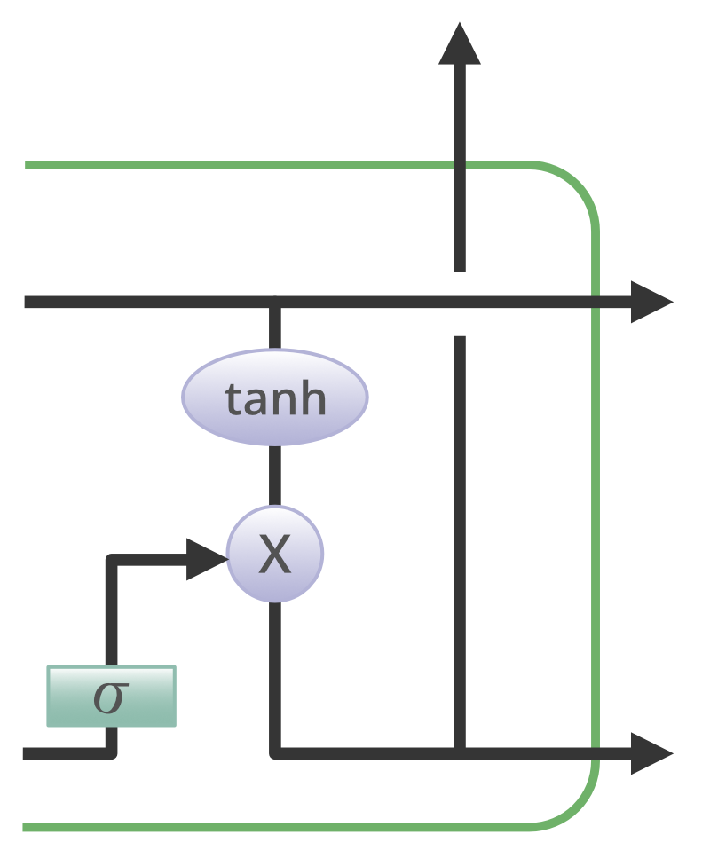

LSTM: output gate
Output gate extracts useful information from the current cell state.
First, it uses the sigmoid function to filter the values based on ht-1 and xt.
Second, it generates a vector by applying tanh function on the cell.
Third, the values of the vector and the selected values are multiplied and sent as an input to the next cell.

Slide 11

LSTM: big picture

Slide 12
Seq-to-seq
Seq-to-seq takes as an input a sequence of words (sentence) and generates an output sequence.
Seq-to-seq uses recurrent neural networks (usually LSTMs or GRUs).
The model consists of two components: encoder and decoder.
Seq-to-seq is also known as Encoder-Decoder Network.

Slide 13
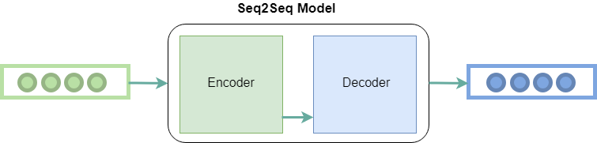
Seq-to-seq
Encoder converts the input words to the hidden vectors. Each vector represents the current word and its context.
Decoder takes as input the hidden vector generated by encoder, its own hidden states and current word to produce the next hidden vector and predict the next word.

Slide 14
Why do we need Attention?
The input to the decoder is a single vector which has to store all previous context. This is a problem for large sequences.
Attention allows the decoder to look at the input sequence selectively.
The crucial difference is in the decoding phase. Attention models compute the context vector c(t) based on the previous alignments.

Slide 15
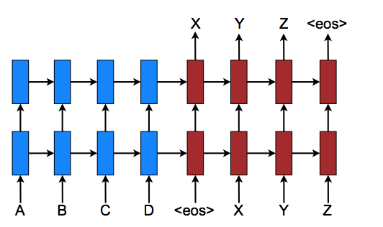
No Attention
Machine Translation with a recurrent neural network (RNN).
Here we translate a source sequence A B C D into a target sequence X Y Z.

Slide 16
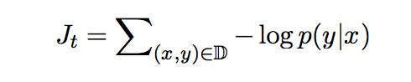
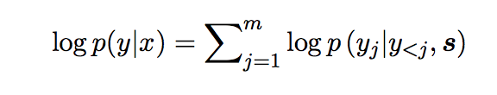
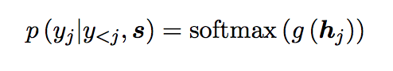
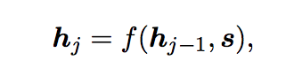
No Attention: predicting y given x

Slide 17
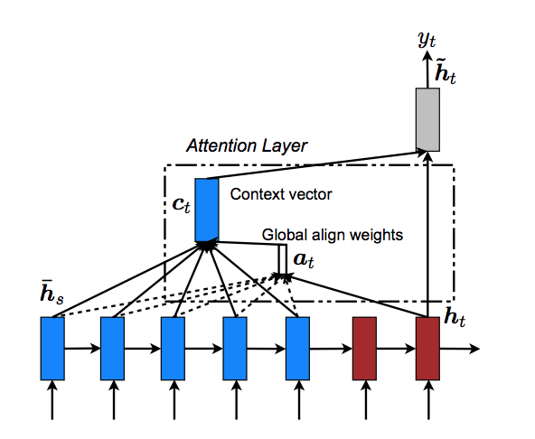
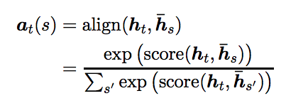
Attention!
At each time step t, the model infers an alignment vector at based on the current target state ht and all source states ħs.

Slide 18

Attention!
Context vector, ct is computed as the weighted average, according to at, over all source states.
The context of every word depends on its alignment weights and hidden states of the encoder.

Slide 19
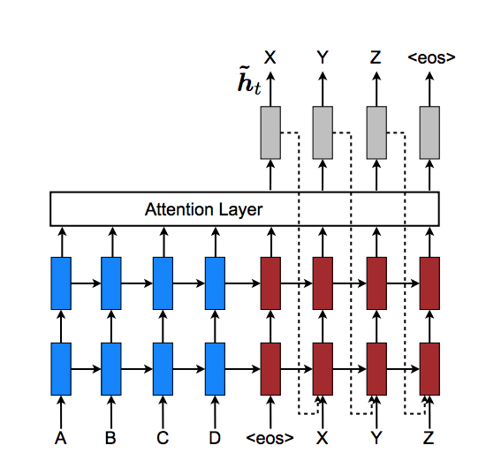
Attention!
Attentional vectors are fed to the next time step to inform the model about previous alignments.
Therefore, the model focuses only on sub-parts of the sentence during translation!

Slide 20
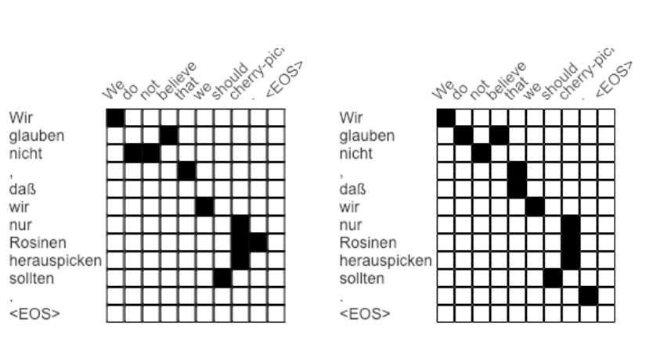
Aligned with attention vs reference alignment

Slide 21
Machine Translation Analogy
Contextual Word Vectors or CoVe (McCann et al. 2017) were inspired by neural Machine Translation.
CoVe embeddings are learned by an encoder in an attentional seq-to-seq translation model.
Unlike Word2Vec & Family, CoVe embeddings are functions of the entire input sentences.

Slide 22
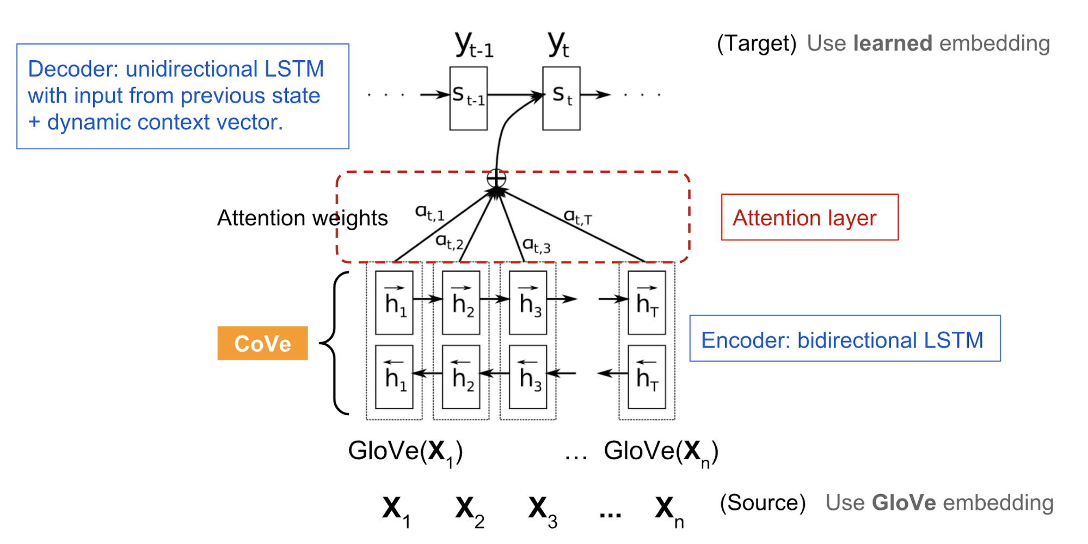
Neural Machine Translation & CoVe

Slide 23
Contextual Embeddings
Hidden states of MT encoder are defined as context vectors:
CoVe(x)=biLSTM(GloVe(x))
We can concatenate GloVe and CoVe for question-answering and classification tasks.
v=[GloVe(x);CoVe(x)]
GloVe learns from global word co-occurrences, while CoVe is generated by processing text sequences and it is able to capture the context.

Slide 24
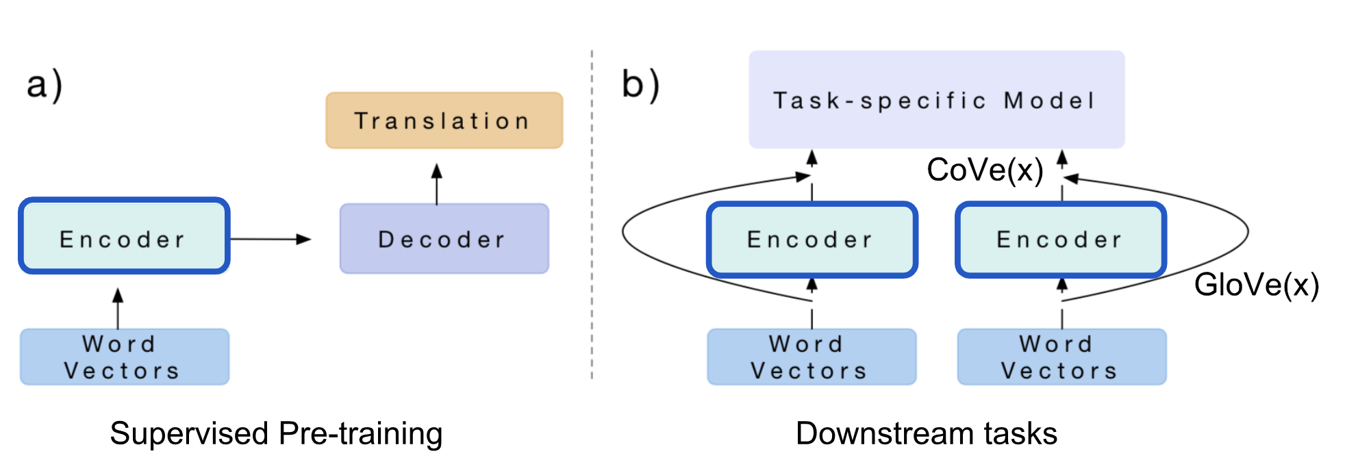
Contextual Embeddings

Slide 25
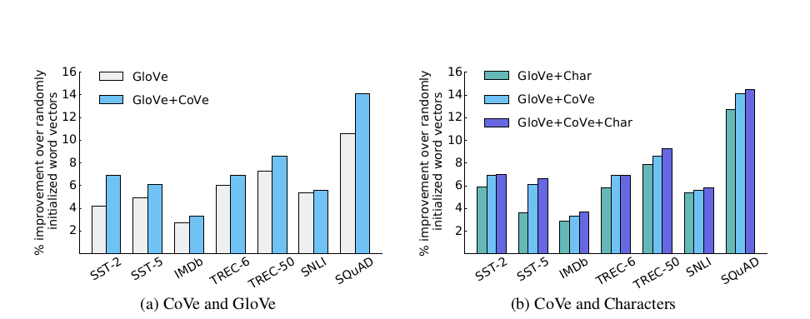
Contextual Embeddings

Slide 26
Contextual Embeddings
Limitations:
pre-training depends on available datasets (supervised translation)
CoVe requires task-specific architecture (different models for different downstream tasks)

Slide 27

ELMo
Embeddings from Language Model
(Peters, et al, 2018)
ELMo learns contextualized word representations by pre-training a language model in an unsupervised way.

Slide 28
ELMo
Like CoVe, we want to make use of deeper layers of NNs.
Unlike CoVe, we want to rely only on unlabeled corpora!
Additionally, ELMo uses character-level convolutions to extract subword information which partially solves Out-Of-Vocabulary problem.

Slide 29
ELMo
Architecture:
bidirectional language model (biLM): biLSTM as next- and previous-word predictor
forward and backward directions share weights for token representations and softmax, but internal weights are different.
after training, all the layers are combined in a task-specific weighted sum to form the ELMo representation.

Slide 30
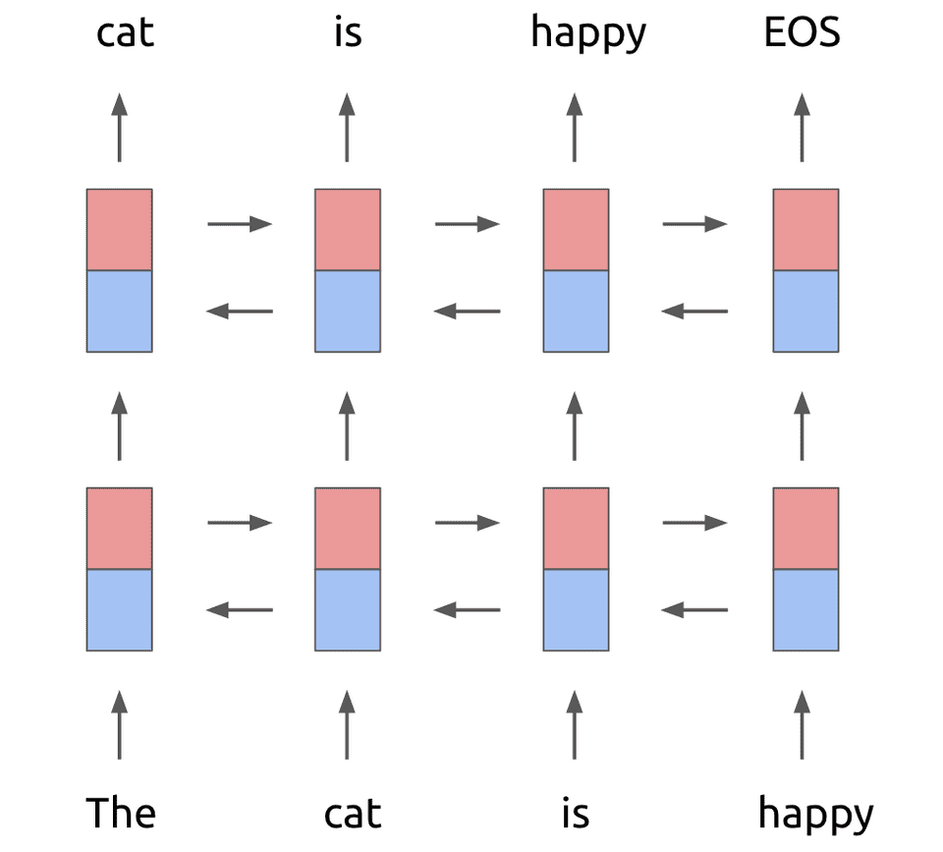
Standard biLSTM

Slide 31
ELMo
Architecture:
bidirectional language model (biLM): biLSTM and a next- and previous-word predictor
forward and backward directions share weights for token representations and softmax, but internal weights are different.
after training, all the layers are combined in a task-specific weighted sum to form the ELMo representation.

Slide 32
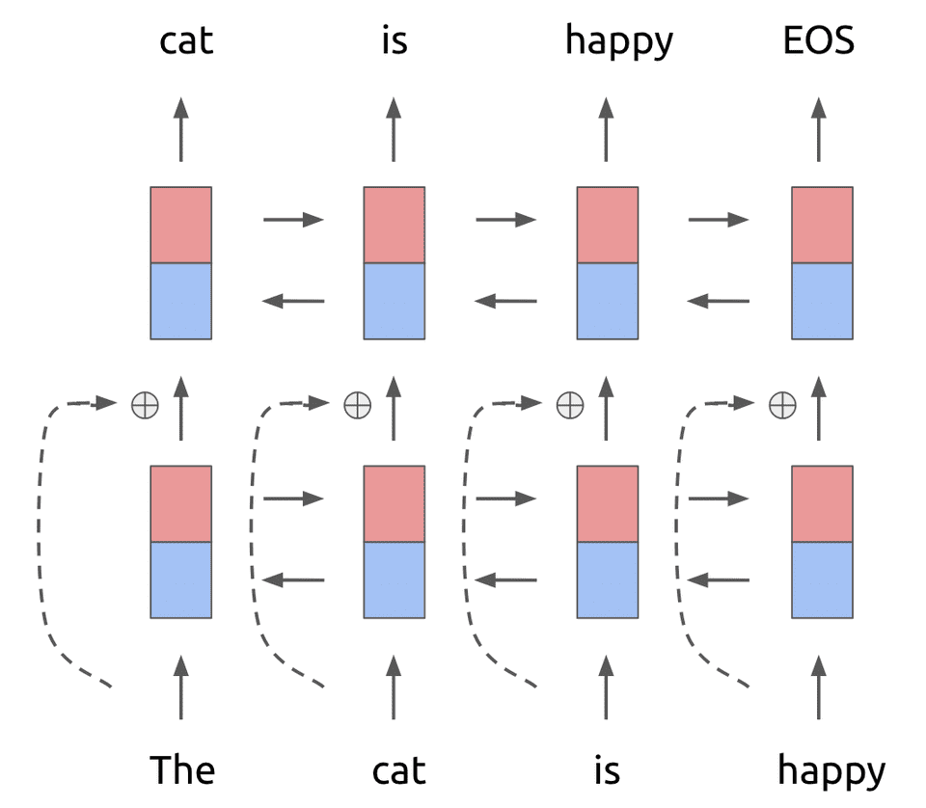
ELMo: biLSTM with residual connections
Residual connections a.k.a. 'skip connections' are used to allow gradients directly flow through the network, without passing through non-linear activation functions.

Slide 33
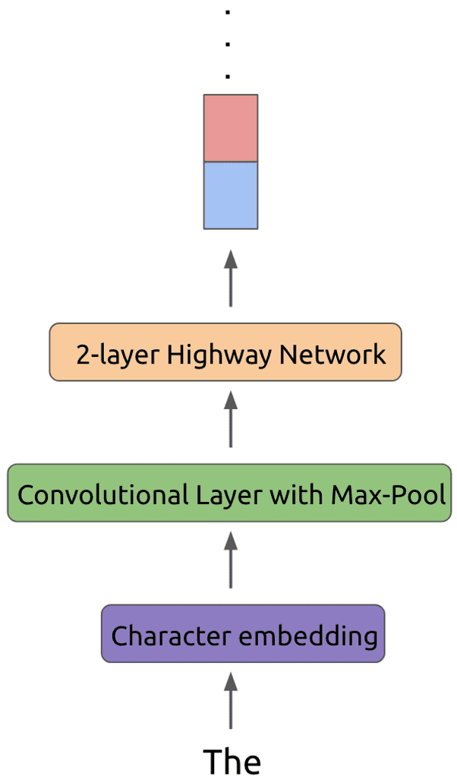
ELMo: from token to biLSTM
Highway layers use residual connections, adding the input to the output.

Slide 34
ELMo
Architecture:
bidirectional language model (biLM): biLSTM and a next- and previous-word predictor
forward and backward directions share weights for token representations and softmax, but internal weights are different.
after training, all the layers are combined in a task-specific weighted sum to form the ELMo representation.

Slide 35
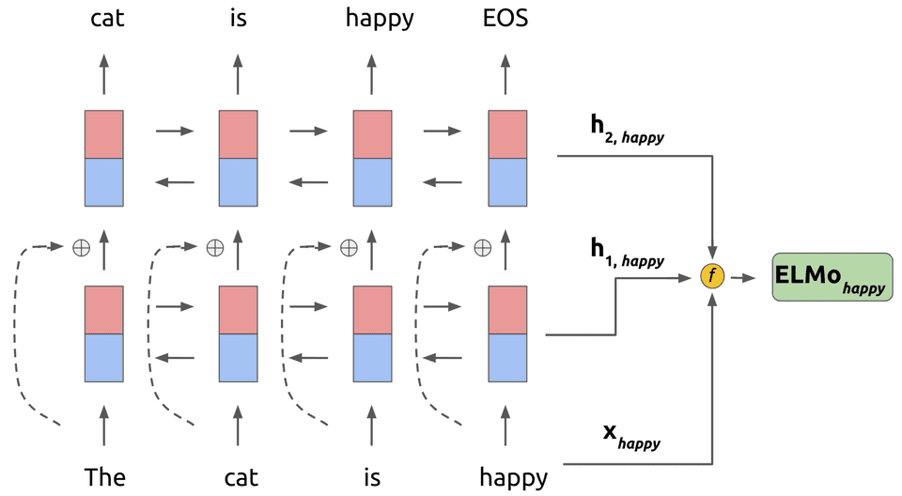
ELMo: let's put it all together

Slide 36
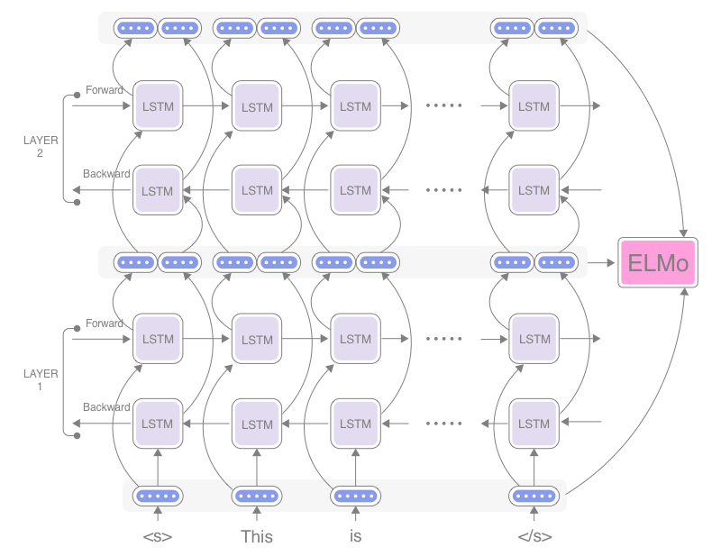
ELMo: the Big Picture

Slide 37
ELMo: the Big Picture
biLM provides three layers of representation for each input token.
ELMo is a task specific combination of the intermediate layer representations in the biLM.
To include ELMo in a downstream model, we need to collapse all layers into a single vector.
We freeze the weights of the biLM and concatenate ELMo vector with the input xk and pass it into the task network.

Slide 38
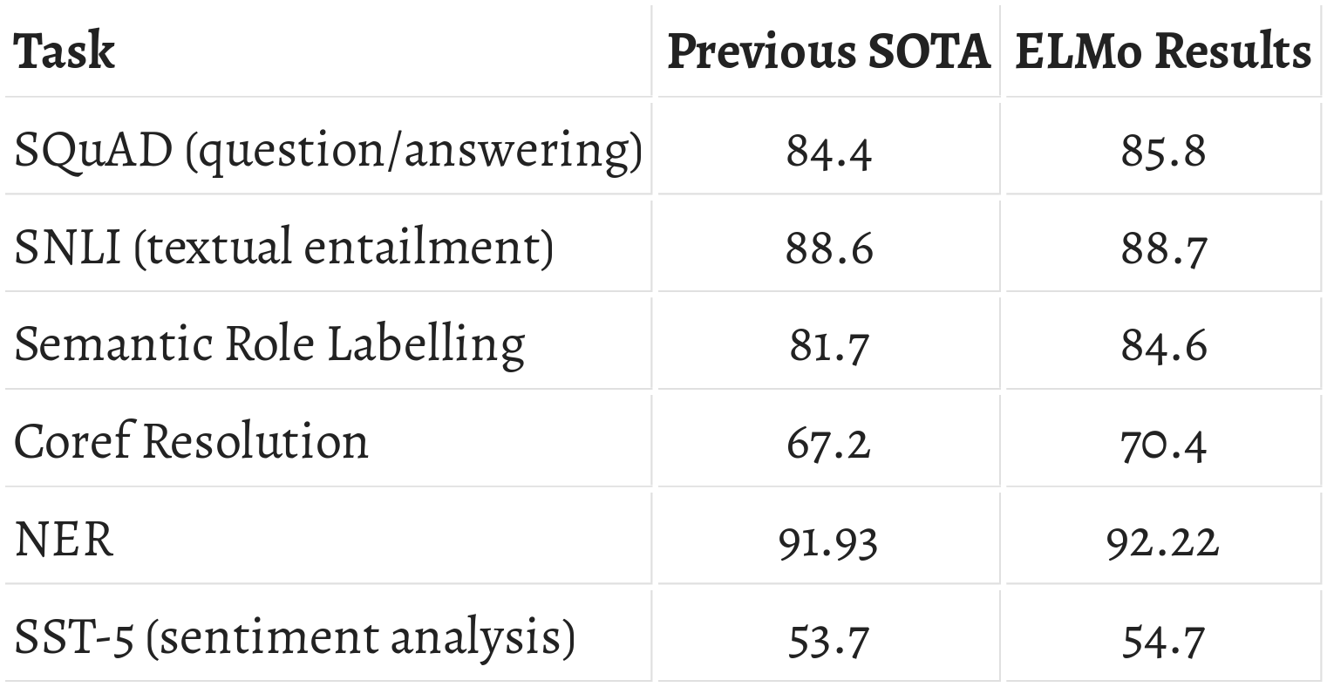
ELMo: Evaluation

Slide 39
ELMo: ablation analysis
Using deep contextual representations are better than just adding the top layer from biLM or MT encoder.
It provides richer representations then CoVe!
Syntactic information is better represented at lower layers.
Accuracy for POS tagging is higher when the first biLM layer is used.
Semantic information is captured at higher layers.
Accuracy for WSD is higher when the biLM top layer is used.

Slide 40
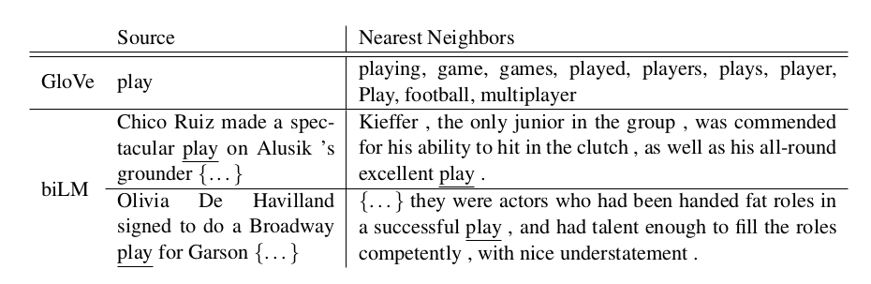
Nearest neighbors: GloVe vs ELMo

Slide 41
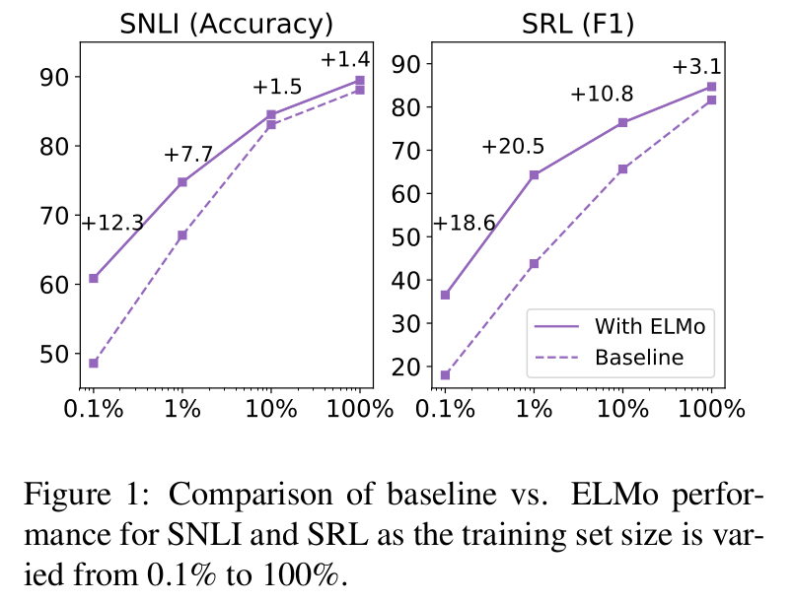
ELMo: when the size matters...

Slide 42
ELMo: Conclusion
ELMo uses deep context-dependent representations from biLMs.
It showed better performance on all downstream tasks.
ELMo can be easily integrated in the existing neural models.
biLM layers encode different types of syntactic & semantic information.
Fine-tuning of biLMs on domain specific data leads to lower perplexity and better performance.
Therefore, biLMs allow domain transfer!

Slide 43
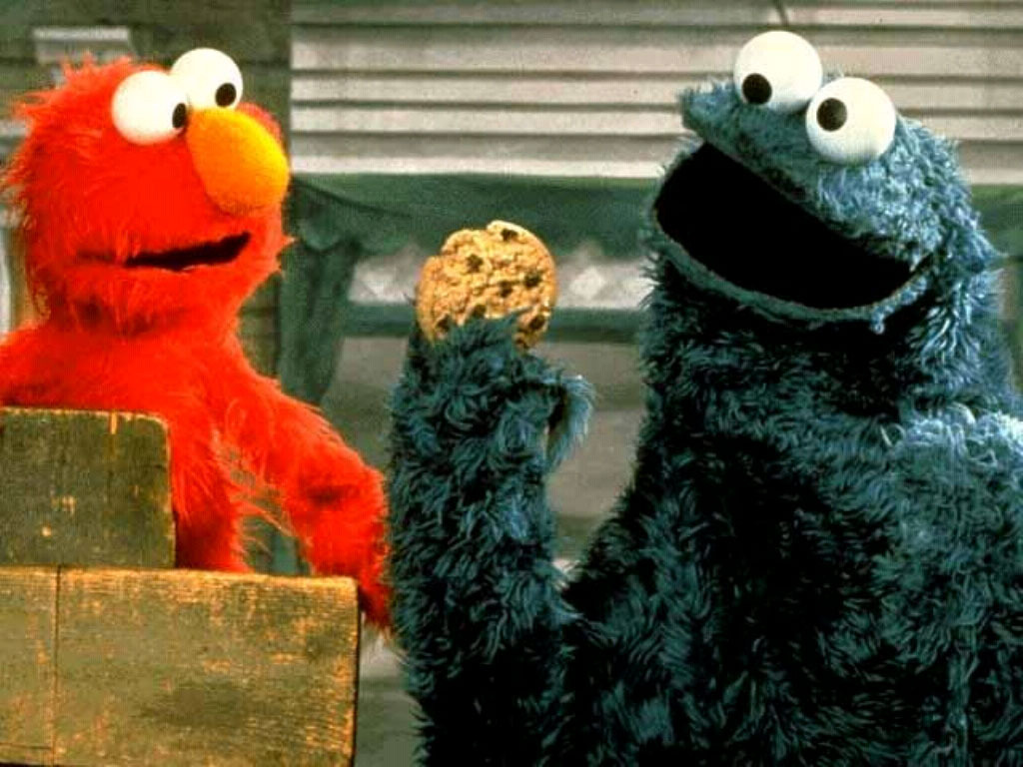
That's cool! Let's have some cookies...
Contextual ELMo: representation for each word depends on the entire context.
Deep ELMo: word representations combine all layers of a deep pre-trained neural network.
Character based ELMo: characters allow the network to use morphological clues & help with out-of-vocabulary tokens.

Slide 44
Contextual String Embeddings for Sequence Labelling
Alan Akbik, Duncan Blythe, Roland Vollgraf

Slide 45
Types of Word Embeddings
Classical word embeddings Capture latent syntactic and semantic similarities
Character-level trained word embeddings Capture task-specific subword features
Contextualised word embeddings Capture semantics in context!

Slide 46
Contextual String Embeddings
Trained unsupervised without notion of words (word/sentence boundaries)
Model words as sequence of characters
Contextualised by their surrounding text
Polysemous words will have different embeddings depending on their context!
Therefore able to handle rare words!
Suitable for various sequence-labelling tasks

Slide 47
Context and Strings
FastText uses n-grams to capture subword information and works great for syntactic tasks!
CoVe uses context words and improves over pre-trained Glove and Glove concatenated with n-gram embeddings but without context!
ELMo is mostly word-level and contextual, but a massive model with large vocabulary!
Contextual String Embeddings combine character and context information!

Slide 48
Character-Level Language Model
Modelling language as distribution over character rather than word sequences
Learning subword structures that capture syntactic and semantic properties (prefixes, suffixes)
Word-level embeddings can be generated from the LM's hidden states

Slide 49
Character-Level Language Model
BiLSTM to encode long-term dependencies
Characters as atomic units
Hidden state for each character in the input sequence

Slide 50
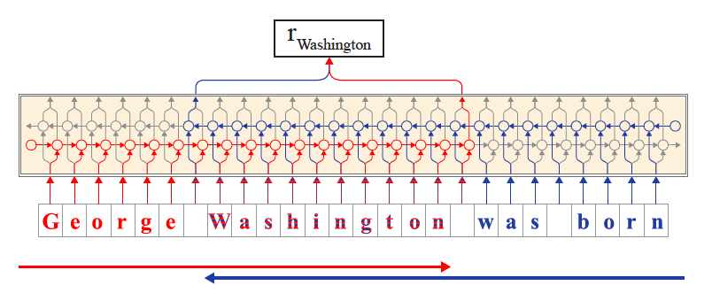
Extraction of Word Embeddings
We can take into account the surrounding words for the embedding!

Slide 51
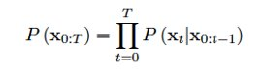
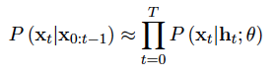
Character-Level LM – Forward Model
Goal: Estimate the probability distribution over sequences of characters: by learning the conditional probability P(x_{t}|x_{0:t-1}): where θ designates the model parameters (weights V and bias b) of the RNN and h_{t} designates the past of the character sequence.

Slide 52
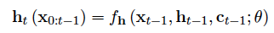
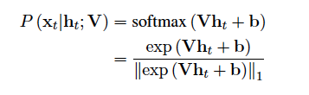
Character-Level LM – Forward Model
h_{t} is computed until character x_{t-1} by applying a function f to the previous character x_{t-1}, the past of the sequence h_{t-1} and the LSTM memory cell c_{t-1}
The likelihood of every character is calculated with softmax:
Notes:
Softmax takes sum of the absolute numbers (l1 norm) = sum of all i (|xi|), l1 norm is regularization method to avoid overfitting

Slide 53
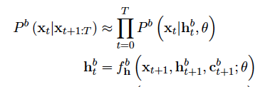
Character-Level LM – Backward Model
The backward model P^{b}(x_{t}|x_{0:t-1}) operates the same in reverse:

Slide 54
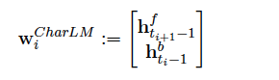
Extraction of Word Embeddings
The final word embedding w consists of a concatenation of these hidden states: where h^{f} designates the hidden state after the last character and captures syntactic-semantic information from the sentence beginning until this character h^{b} designates the hidden state before the first character and captures syntactic-semantic information of the sentence from the end of the sentence until this character.

Slide 55
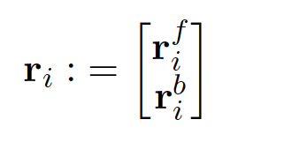
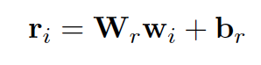
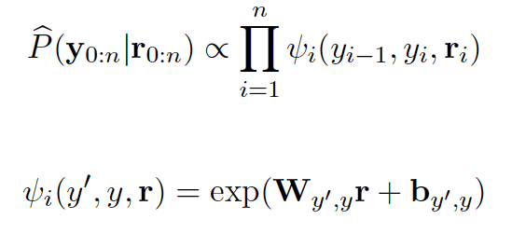
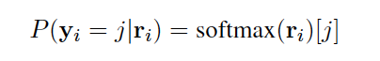
Sequence Labelling Model
The retrieved word embeddings are used as input to a BiLSTM.
The forward r_{i}^{f} and backward r_{i}^{b} output states from the BiLSTM are concatenated to r_{i}:
Serves as input into the CRF to calculate the final sequence probability over possible sequence labels y:
Or as input the a simple FFN: where the label is then predicted by softmax:

Slide 56
Experiments
Variations of the contextual string embeddings and other baseline word embeddings were used on 4 sequence labelling tasks using the BiLSTM-CRF sequence labelling model:
Named Entity Recognition (NER) in German Text
Named Entity Recognition (NER) in English Text
Chunking
POS-Tagging

Slide 57
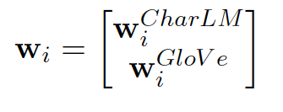
Compared Embeddings
Baselines
Contextual String Embeddings
Classic pre-trained embeddings (Huang et al. 2015)
Task-trained embeddings with character features (Lample et al. 2016)
Pre-trained contextual word embeddings (Peters et al. 2018)
Proposed approach
Proposed_{+word} (concatenation with glove word embeddings)
Proposed_{+char} (concatenation with task-trained character features)
Proposed_{+word+char} (concatenation with pre-trained and task-trained)
Proposed_{+all} (Concatenation with all above)

Slide 58
Training
LM:
Stochastic Gradient Descent with learning rate of 20.0, batch size of 100, clipping gradients at 0.25 and dropout with probability 0.25
2048 LSTM hidden states
English models trained on 1B word corpus
German models trained on ½B word corpus from OPUS
Training on this size due to limited resources (FastText trained on 6 – 42B words), otherwise a better LM would have been possible
Sequence Labelling Model:
SGD with clipping gradients at 5 for 150 epochs and learning rate
adaptation based on training loss, 256 LSTM hidden states
Notes:
Gradient clipping: Clip the gradients to a threshold value to avoid having overly large/steep gradients and overshooting the minimum
Dropout: Ignoring a neuron with probability p to avoid learning too much and therefore be able to generalize better in testing

Slide 59
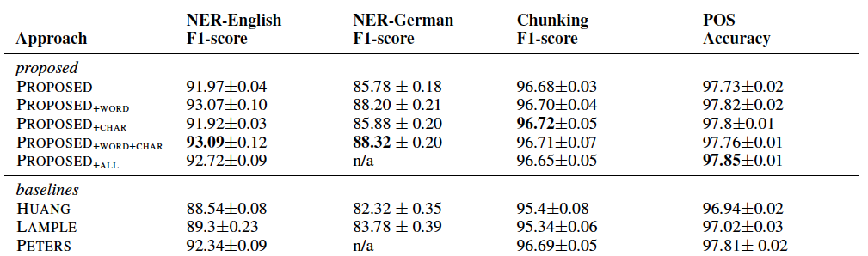
Results
Notes:
- New SOTA for NER in DE and EN (semantic)
- Improvements for Syntactic Tasks, but not as much as for NER
- Concat with traditional word embeddings helpful (prop + word, prop + word + char)
- Concat only with task-specific char features useless (prop + char)

Slide 60
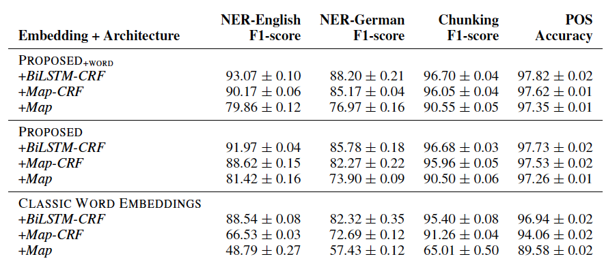
Quantitative Results
Replacing the BiLSTM-CRF with the FFN
Understanding how powerful the embeddings perform without such a complex sequence labelling architecture
Notes:
- Only 3% decrease in performance when replacing BiLStM with lin. Map for prop + word for NER
- 20% decrease for classical word embeddings for NER
- Less decrease for classical embeddings in syntactic tasks but still more than for proposed approach
-> Proposed approach is more robust, conveyes more meaning and requires less powerful architectures for seq labelling tasks

Slide 61
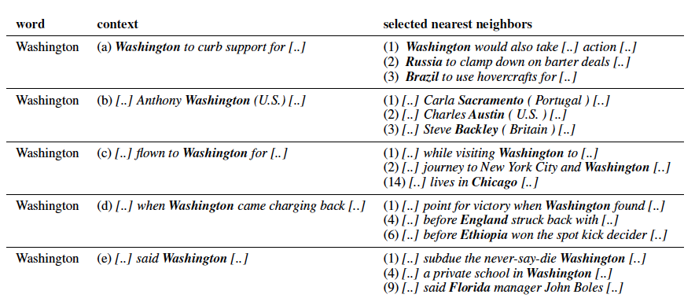
Qualitative Results
Example embeddings for polysemous words:
Notes:
- CSEs successfully distinguish the polysemous word Washington in different contexts (political entity, surname, city, sports team)
- Negative example with too little context (only "said")

Slide 62
Conclusion
Contextual String Embeddings greatly outperforms the SOTA for NER in English and German
They slightly improve over the SOTA for chunking and POS-Tagging (syntactic tasks)
Addition of classic word embeddings leads to more improvement (Proposed + word)
Task-specific character features do not improve results
Character-based LM is trained easier (no tokenization, smaller vocabulary) and can therefore be used for lower-resource languages
ELMo was trained 5 weeks on 32 GPUs, CSEs were trained in 1 week on 1 GPU!

Slide 63
OpenAI - GPT
Improving Language Understanding by Generative Pre-Training
Alec Radford, Karthik Narasimhan, Tim Salimans, Ilya Sutskever

Slide 64
Contents for OpenAI-GPT
Problem
Approach
Architecture
Tasks and Data
Results
Drawbacks
Version 2

Slide 65
What's the problem?
Most Deep Learning methods need lot of labeled data
Restriction in domains where there is lack of data
Manual Annotation => expensive + time consuming
Objectives are different for different tasks
Transfer Learning for different tasks is challenging!
What's the most effective way to transfer the learning?

Slide 66
Approach
Unsupervised pre-training of a "transformer decoder" on huge text data
Supervised task-oriented "fine-tuning" on smaller datasets

Slide 67
Approach
Semi-supervised approach (unsupervised + supervised)
Succeeds in lot of "language tasks" just like ELMo
Faster than ELMo, as it uses one single architecture
Similar to Fast.ai's ULMFiT model, but using transformers

Slide 68
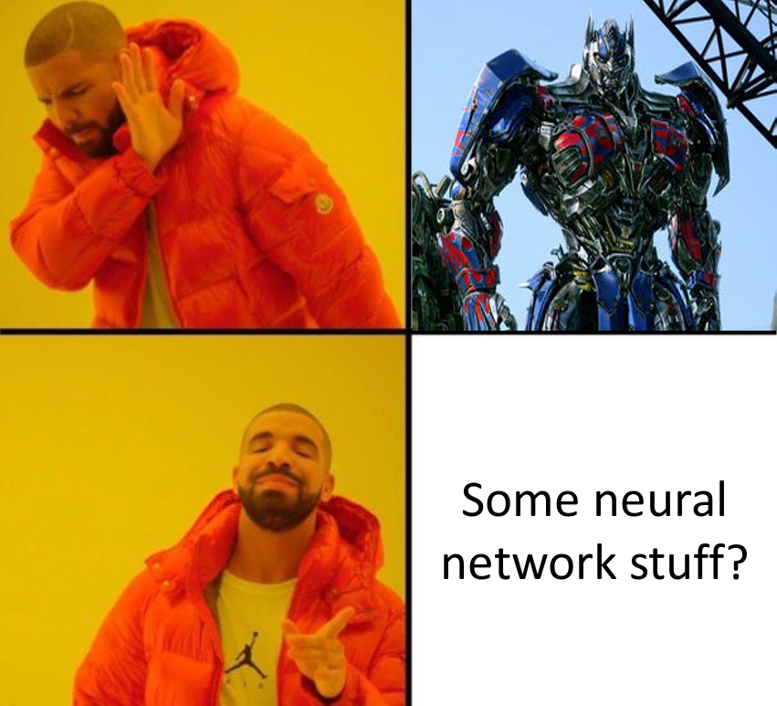
What are transformers?

Slide 69

Transformer
"Transforms" one text sequence to another text sequence
Going beyond LSTMs

Slide 70

Transformer
Transformer = Encoder + Decoder

Slide 71
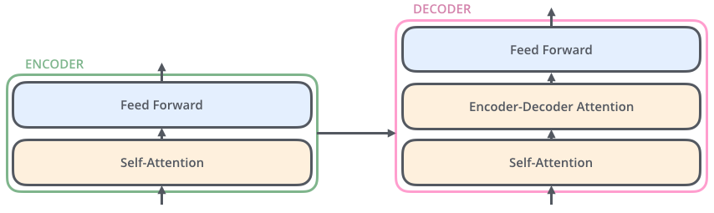
Transformer
Encoder/Decoder = Attention + Feed-forward NN

Slide 72

Transformer
Self-Attention (attention
on itself)
For each word, check
which words in the same
text are more important

Slide 73

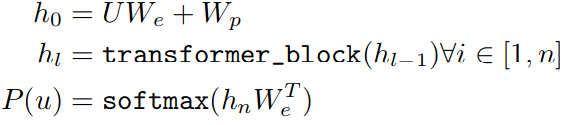
OpenAI Transformer
Decoder is a good choice
for language modeling,
unlike BiLSTMs
Stack of 12 decoder layers
No encoder-decoder attention layer (no encoders)
Multi-headed self-attention layers over input context tokens
U = context vector of tokens
We = token embedding matrix
Wp = position embedding matrix
hx = tranformer output (at x)
n = number of tokens

Slide 74
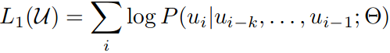
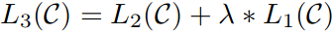
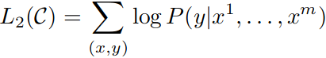
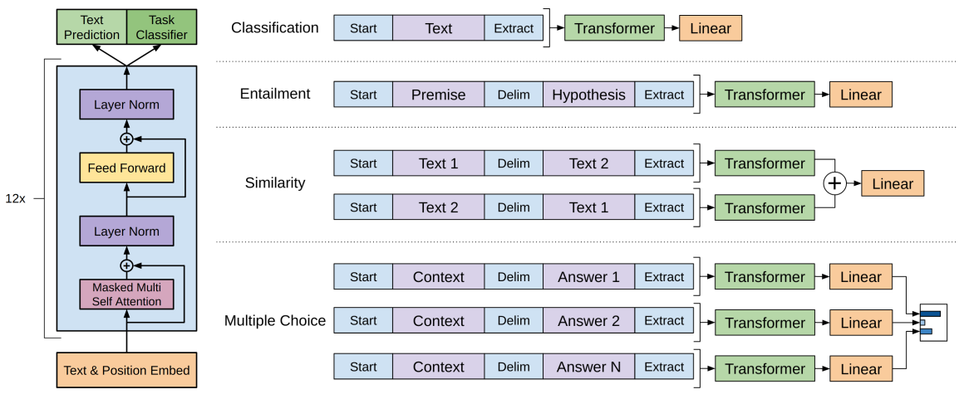
Architecture

Slide 75
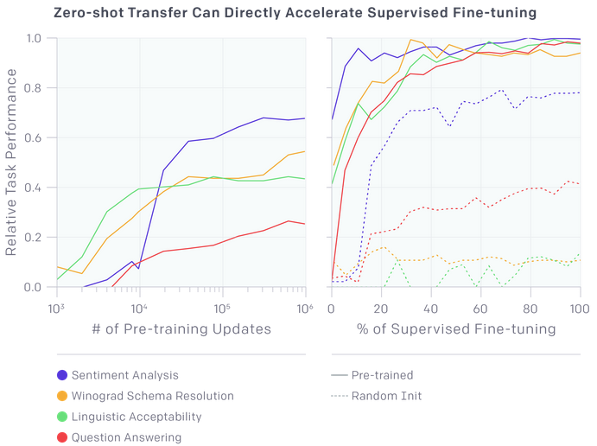

Slide 76
Tasks and data
Task | Dataset / Corpus
Natural Language Inference | SNLI, MultiNLI, Question NLI, RTE, SciTail
Question Answering | RACE, Story Cloze
Sentence similarity | MSR Paraphrase Corpus, Quora Question Pairs, STS Benchmark
Classification | Stanford Sentiment Treebank – 2, CoLA

Slide 77

Results (Natural Language Inference)

Slide 78

Results (QA, Commonsense Reasoning)

Slide 79

Results (Semantic similarity, Classification)

Slide 80
Its great, but...
Improves SotA on 9 out of 12 datasets!
Pre-training for 1 month with 8 GPUs!!!
Textual information is limited :(
Language is still a mystery ...

Slide 81
OpenAI GPT-2 (2019)
Successor to the GPT-1 model (with more data!)
Predict the next word, given all of the previous words within some text
40 GB data (8 million web pages)
1.5 billion model parameters (> 10x)
Data is released, but not the trained model

Slide 82

BERT
Bidirectional Encoder Representation from Transformers
(Jacob Devlin, Ming-Wei Chang, Kenton Lee, Kristina Toutanova)

Slide 83
Introduction
Most SOTA machine learning strategies are unidirectional
Limits possible architectures
Enter: BERT
Bidirectional model
Better than previous SOTA models (e.g. ELMo, OpenAI-GPT) in 11 different tasks
Stated that BERT's most important feature is bidirectionality
Two variations: BERT_Base & BERT_Large

Slide 84
Model Architecture
Multi-layer bidirectional Transformer encoder
Only uses Transformer's encoder
Size:
Bert_Base: L = 12, H = 768, A = 12, Total Parameters = 110M
Bert_Large: L = 24, H = 1024, A = 16, Total Parameters = 340M
BERT_Base has the same size as OpenAI-GPT
BUT: BERT bidirectional, while OpenAI unidirectional

Slide 85

Model Architecture

Slide 86

Input

Slide 87
Training Procedure
Pre-trained with two tasks
Masked Language Modeling (MLM)
Next Sentence Prediction (NSP)
Fine-Tuning

Slide 88
Masked Language Model
Instead of training on whole input: randomly mask some tokens ([MASK]-embedding) and only predict these
Drawback: Masking only in pre-training
Solution: choose different token for certain percentage of words

Slide 89
Next Sentence Prediction
Model for sentence relations
Task:
Takes paired sequence
Classifies if 2nd sentence (B-embedding) is the sentence after 1st in text
True in 50% of cases

Slide 90
Still awake?

Slide 91
Fine tuning
As only new parameter
K = number of classifier labels
Probabilities computed with softmax
Hyperparameters stay the same
Dropout probability = 0.1
Process needs to be adapted for certain tasks
Best parameter values depend on task

Slide 92
Experiments
BERT tested on 11 NLP tasks from 4 datasets
GLUE (General Language Understanding Evaluation)
SQuAD (Stanford Question Answering)
SWAG (Situations With Adversarial Generations)

Slide 93
GLUE - Background
NLP task collection (Including Multi-Genre Natural Language Inference (MNLI) and Quora Question Pairs (QQP))
Purpose:
Distribute already split datasets
Provide Server for testing
BERT does not need to be adapted

Slide 94
SQuAD - Background
Collection of 100K question-answer pairs
Input: Question and paragraph from Wikipedia
Task: Predict if answer is in paragraph
BERT needs to be adapted:
Input: Question gets A-embedding, paragraph gets B-embedding
Start vector and end vector

Slide 95
SWAG - Background
113K sentence pairs
Task: Decide for most plausible followup sentence from 4
BERT adapted simmilarly to SQuAD
Sentence: A-embedding, Possibilities: B-embedding
Task specific vector , (dotproduct with final representation to score possibilities)

Slide 96
Results
BERT_Base and BERT_Large both better than previous SOTA
Worst results in Named Entity recognition(BERT_Large: 0.2%)
Best results in SWAG(27.1%)
BERT_Large better than BERT_Base
Model size is important

Slide 97

Glue - Results

Slide 98

SQuAD - Results

Slide 99

SWAG - Results

Slide 100
Conclusion

Slide 101
Conclusion
Contextual Embeddings
Context improves CoVe over systems without context
Context improves semantic performance, subword information improves syntactic performance
Small vocabulary leads to efficient training

Slide 102
Conclusion
ELMo
Embeddings learned from internal state of bidirectional LSTM & represent contextual features of input text
Based on character-based representations
Helps with out of vocabulary-words
Easy to integrate in existing models

Slide 103
Conclusion
OpenAI GPT
Transfer learning by generative pre-training transformer decoder and discriminative fine-tuning on huge amount of text data
Model gets important world knowledge
Better at processing long-range dependencies
Improves SOTA in 9/12 NLP tasks
Drawbacks: computation time, data limitations, etc.

Slide 104
Conclusion
BERT
Bidirectional model
Improves greatly over previous SOTA (up to 27%)

Slide 105

Conclusion

Slide 106

Thank you!

Slide 107
Papers:
Learned in Translation: Contextualized Word Vectors (2017) McCann B., Bradbury J., Xiong C., Socher R. http://papers.nips.cc/paper/7209-learned-in-translation-contextualized-word-vectors.pdf
Deep contextualized word representations (2018) Peters M. E., Neumann M., Iyyer M., Gardner M., Clark C., Lee K., Zettlemoyer L. https://arxiv.org/abs/1802.05365
Alan Akbik, Duncan Blythe, and Roland Vollgraf. "Contextual string embeddings for sequence labeling." Proceedings of the 27th International Conference on Computational Linguistics. 2018.

Slide 108
Papers:
Radford, Alec, et al. "Improving language understanding by generative pre-training." URL https://s3-us-west-2.amazonaws.com/openai-assets/research-covers/language-unsupervised/language_understanding_paper.pdf (2018).
Radford, Alec, et al. "Language models are unsupervised multitask learners." OpenAI Blog 1 (2019): 8.
Devlin, Chang, Lee, Toutanova "BERT: Pre-training of Deep Bidirectional Transformers for Language Understanding"

Slide 109
Further References & Resources:
https://towardsdatascience.com/attention-based-neural-machine-translation-b5d129742e2c
https://www.geeksforgeeks.org/deep-learning-introduction-to-long-short-term-memory/
https://www.geeksforgeeks.org/seq2seq-model-in-machine-learning/
https://allennlp.org/elmo
https://towardsdatascience.com/elmo-helps-to-further-improve-your-word-embeddings-c6ed2c9df95f
https://towardsdatascience.com/bert-explained-state-of-the-art-language-model-for-nlp-f8b21a9b6270
https://www.mihaileric.com/posts/deep-contextualized-word-representations-elmo/
http://www.realworldnlpbook.com/blog/improving-sentiment-analyzer-using-elmo.html
https://lilianweng.github.io/lil-log/2019/01/31/generalized-language-models.html

Slide 110
Further References & Resources:
http://jalammar.github.io/illustrated-bert/
http://jalammar.github.io/illustrated-transformer/
https://openai.com/blog/language-unsupervised/
https://openai.com/blog/better-language-models/
https://www.giantbomb.com/sesame-street-bert-ernies-imagination-adventure/3030-24259/characters/

